Slide 1

Integrating 3D Vision into Robotics Education
Masters Thesis by Mike Nellis, University of Dayton
Notes:
Talk about how the main intention is to add and extension from the already existent 2D to make 3D

Slide 2
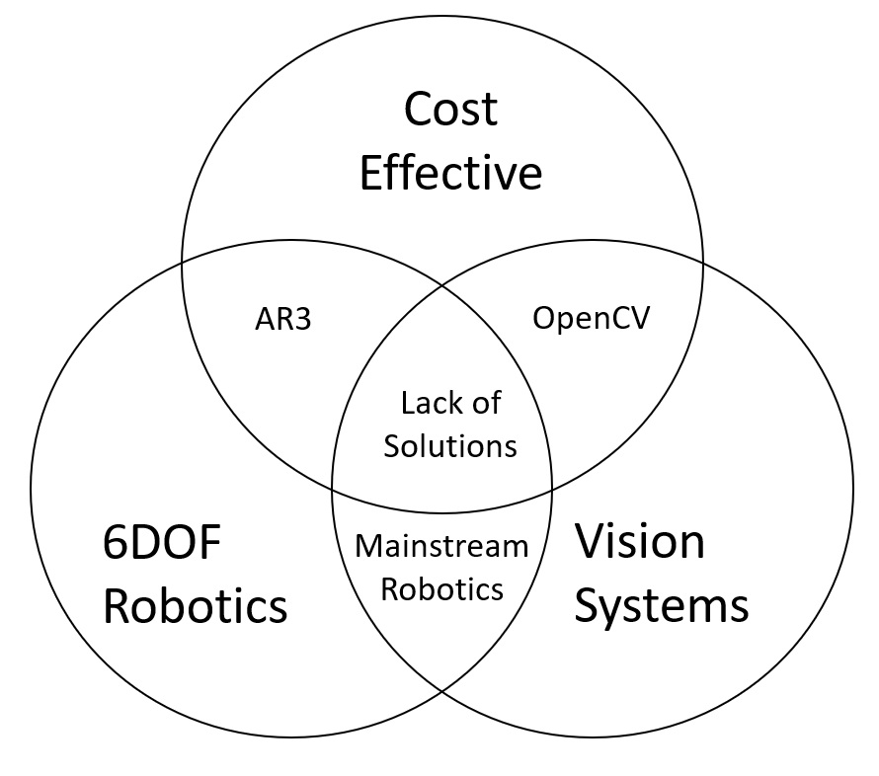
Motivation
New Robotics courses
Use in Industry
The Future in
Automation and
Manufacturing
Notes:
For use in advanced robotics courses with the new minor
Future due to easier design and programming (once vision system is in place) and can additionally be used for inspection

Slide 3
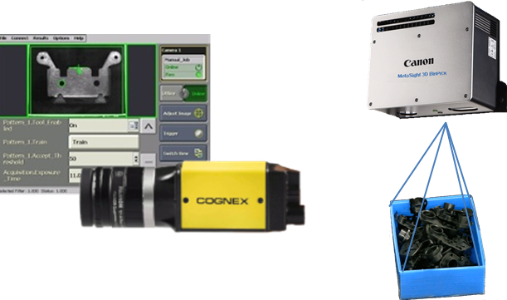
Background – Industry Use
Companies
ABB
Fanuc
Motoman
Costs
Motoman Integrated Vision System
Notes:
Companies already use these technologies, but they come at a cost.

Slide 4
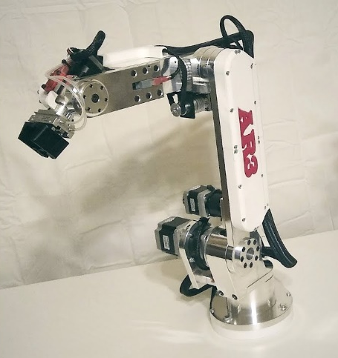
Background – Education Use
What Exists
AR2/AR3 with 2D
OpenVision Control
Preset modules
Computer Applications
Annin Robotics AR3
Notes:
With the goal to be hands on approach to learning

Slide 5
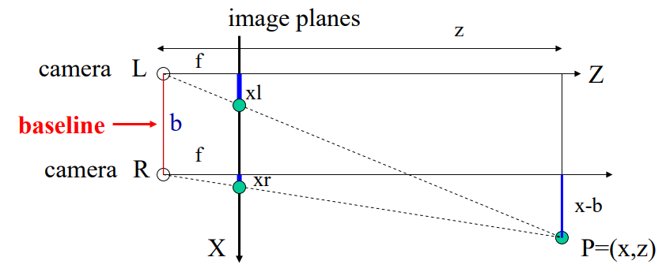
Background – Vision Code
Types of 3D Vision
Optical Flow
Motion Stereo
Stereo Camera
Reconstruction
Disparity Vision Process
Notes:
Optical: intensity of grey values
Motion Stereo: projection size
Stereo Camera Reconstruction-Disparity: Like human vision, compares two images for distance
Note that there are more resources listed in the report for more in depth information, this is a short summary as it is not the most important part of the process.
Disparity takes the difference from parallel on the projected plane, and estimates distance through the geometry. In some more computation heavy this estimation becomes a calculation.

Slide 6
Design Requirements
Open Source
Code
Robotics
Low Cost
Robotics
Notes:
Open source to allow for flexibility in what it is used for, including possibilities for changing how the camera system is used and what function the robot has

Slide 7
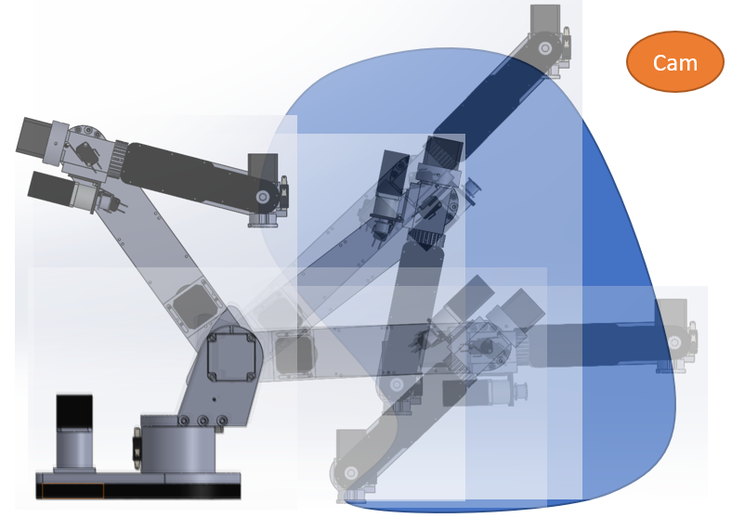
Process – Robot Selection
AR3 System
Encoder system
Workspace calculation
Notes:
Start: Ability to work with Chris Annin directly through this process, Already in use at UD, low cost and open source
Reach Horizontal 23.5 in, 6 in above table surface
Camera Height=24 in above platform

Slide 8
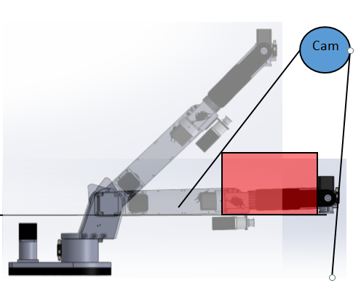
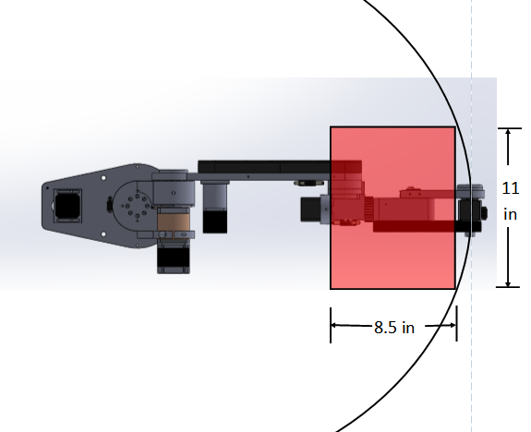
Notes:
Robot arm is required to move out of the way in order to get accurate position of the object in the camera workspace
It is also to be noted that the robot in this position may face singularities that it can only work out of away from the camera and stand

Slide 9
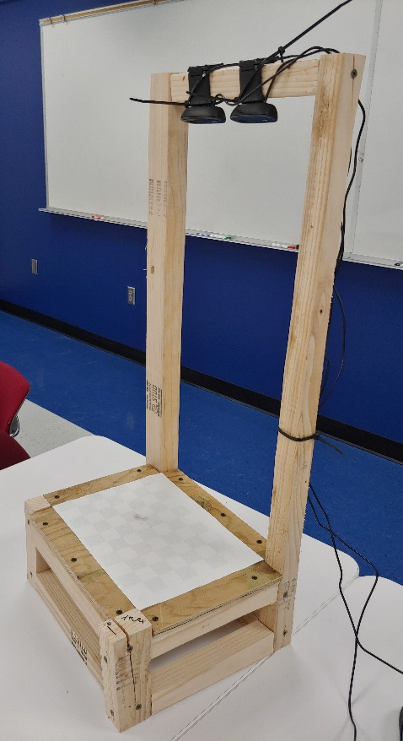
Process – Camera Selection
Logitech C270
Used in both AR3 and
Original Vision Code
Notes:
Note that they do not need to remain parallel when installed, nor have a set distance apart, allowing for change to the system

Slide 10
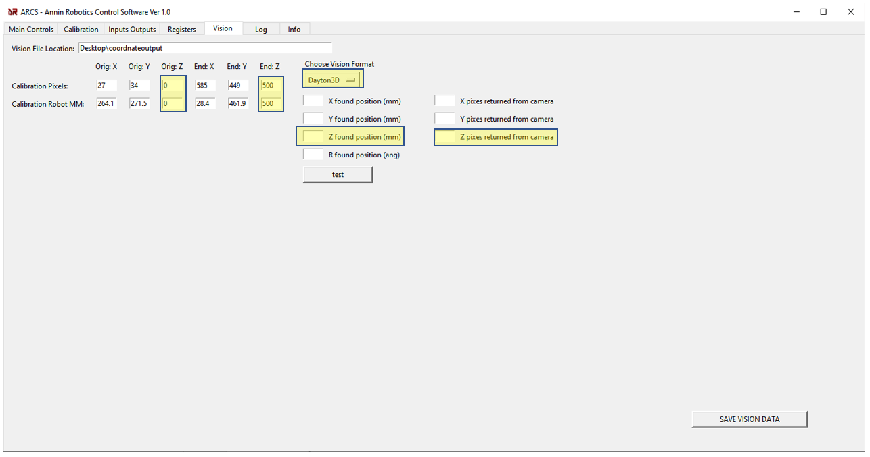
Process – Code
Vision Code
Known Changes for Individual Computers
Add Export Values
Fix/Run Calibration
AR3 GUI
Add Format for 3D Positioning
Add Appropriate Input
Notes:
Emphasize what I did, give credit to PATRIK Reizinger for writing the initial code and to CHRIS ANNIN for the GUI associated with the AR3.
Some parts of the vision code that caused issues are due to a lack of a Mannual, and that all associated materials are in Hungarian.
GUI Code bug for input mismatch (Unresolved) worked with Chris to fix

Slide 11
Process – Flow of Information
Camera
Vision Code
Text File
GUI
Goal to integrate Vision Code into GUI in the Future
Notes:
Process flow is expected to eliminate the Text file when integrated into the GUI, would work with Chris or pass off to him since he is the expert in the GUI

Slide 12
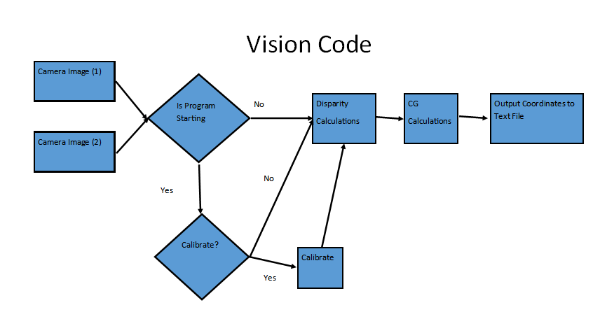

Slide 13
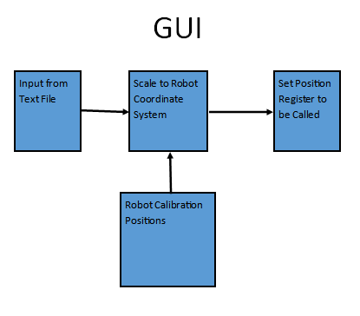

Slide 14
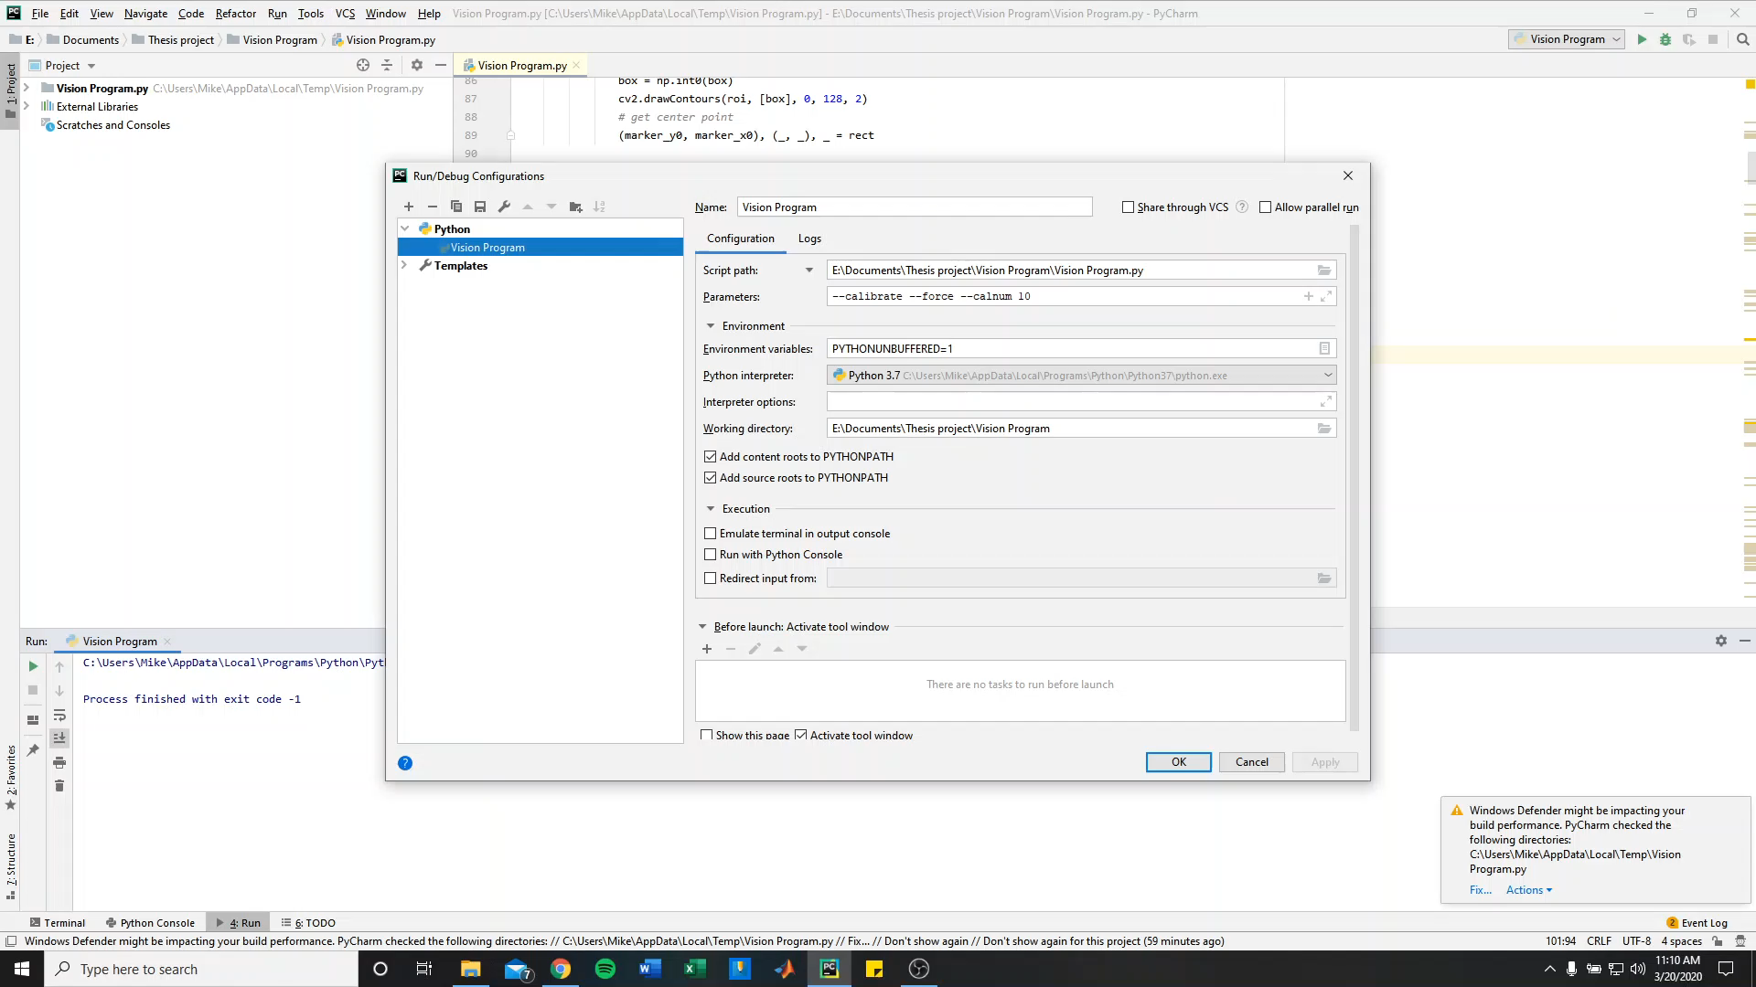
Vision Video
Notes:
Go through the calibration, talk about light levels and how it affects the calibration accuracy, Position output to the command prompt, and touch on the tracking through the windows and the anti-distortion of the cameras
Point out the added position output to workspace and fixed calibration are my contributions

Slide 15
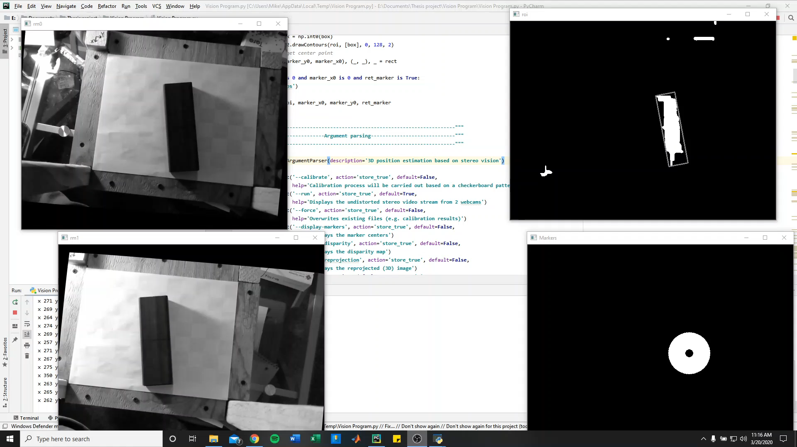
Output Video
Notes:
Note the coordinate output was my work

Slide 16
AR3 GUI
Notes:
Note what was changed to make space for 3D vision program, where input will go

Slide 17
Results – Procedure
Desired Results
XY within .5 inches
Z within .25 inches
Full system to use electromagnet

Slide 18
Results – Point placement for XY Tests
Notes:
Position is measured as the center of gravity to align with what coordinates are output

Slide 19
Results – XY Accuracy
Notes:
Note that it is linear which matters for the position formula the GUI uses to be accurate

Slide 20
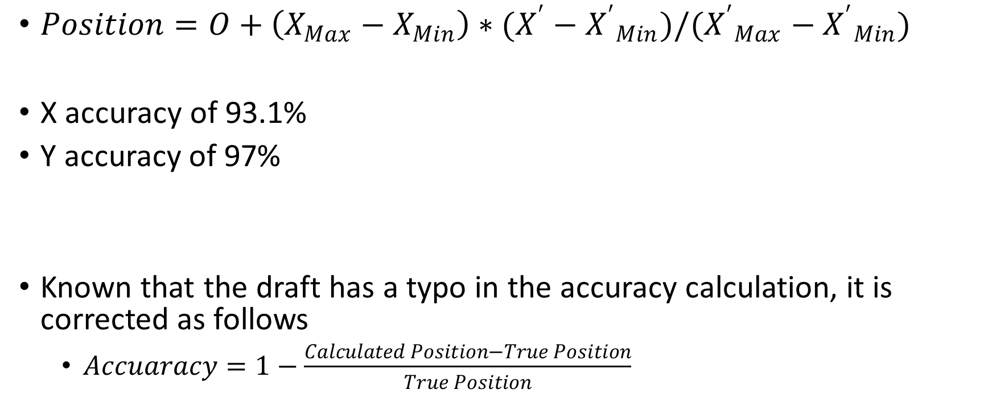
Results – XY Accuracy
$Position=O+\left(X_{Max}−X_{Min}\right)∗(X^{′}−{X^{′}}_{Min})/({X^{′}}_{Max}−{X^{′}}_{Min})$
X accuracy of 93.1%
Y accuracy of 97%
Known that the draft has a typo in the accuracy calculation, it is corrected as follows
$Accuaracy=1−\frac{Calculated Position−True Position}{True Position}$
Notes:
Origin of robotic coordinates for camera workspace + camera workspace range * position in regards to camera origin / camera coordinate range
X off by .17 inches (Averaged), Y off by .04 inches (Averaged)

Slide 21
Results – Z Accuracy
Systematic Outliers
With outliers,
Z accuracy of 47%
Without outliers,
Z accuracy of 94%
Notes:
Systematic outliers when it is directly on platform
Z off by .96, .4 respective of including outliers, not including outliers.

Slide 22
Conclusions
Limited by Accuracy
XY Close
Z may require improvement
Upgrade Electromagnet
Notes:
Electromagnet upgrade to use current 24V source

Slide 23
Extension of Project
Improve Accuracy
Change Camera Location to on Robot Arm
Incorporate into GUI
Notes:
Main focus of the rest of the time to Improve Accuracy, likely by averaging measurements
Will likely pass off to Chris for incorporation into GUI

Slide 24
Resources to be Included
Video Tutorials on how to use programs
All code materials
Test Results from initial accuracy testing
Notes:
What is to be included on the GitHub

Slide 25
Questions?
Notes:
Publishable as part of an engineering education article or as a hardware upgrade paper to Chris Annin

Slide 26
Summary of Contribution
Integrate 3D Stereoscopic Vision and Robotics
Update and debug Vision Code
Add coordinate export
New Vision Function in GUI

